Slide 1
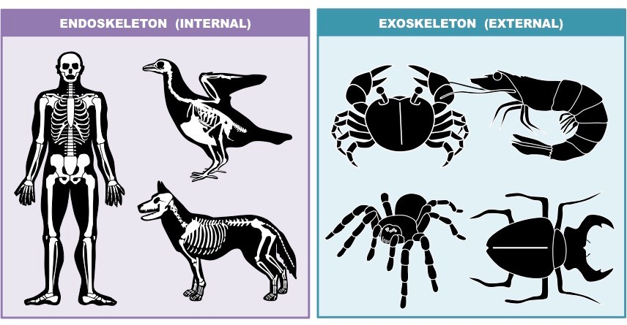
Vertebrates are the animals that have backbone.

Slide 2
Invertebrates are the animals that do not have backbone.

Slide 3
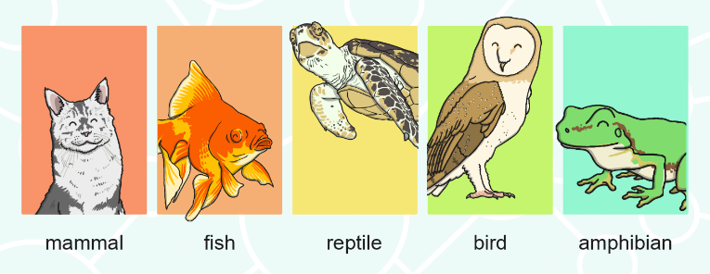
Five groups of vertebrates
Mammals
Fish
Reptiles
Birds
Amphibians

Slide 4

Identify the animal that pops up
Is that a vertebrate or an invertebrate?
Identify the group of vertebrate

Slide 5
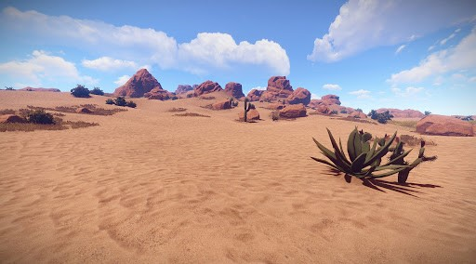
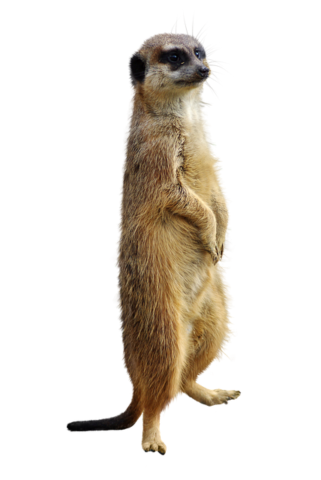
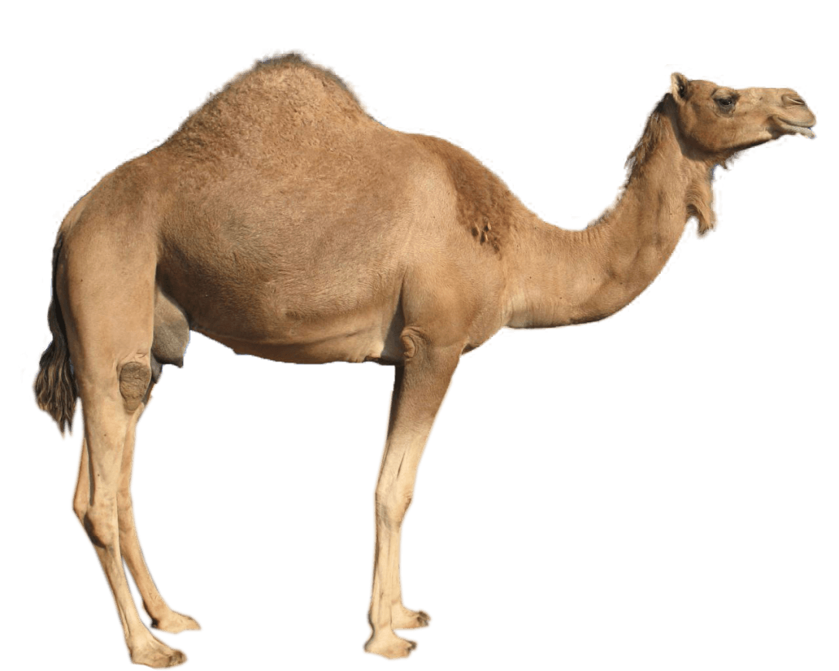
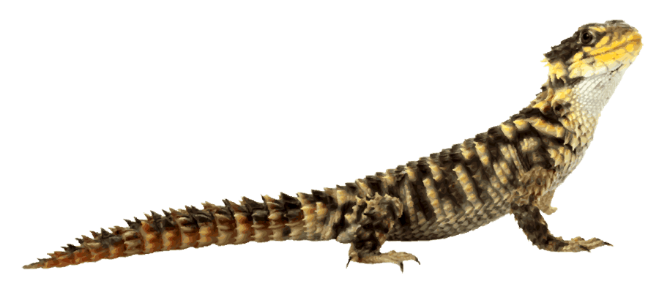
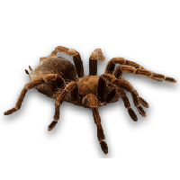
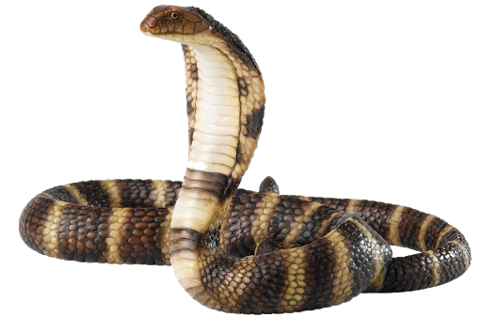
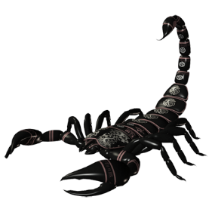
Desert Spider
Lizard
Camel
Invertebrate
Reptile
Meerkat
Mammal
Scorpion
Mammal
Snake
Invertebrate
Reptile

Slide 6
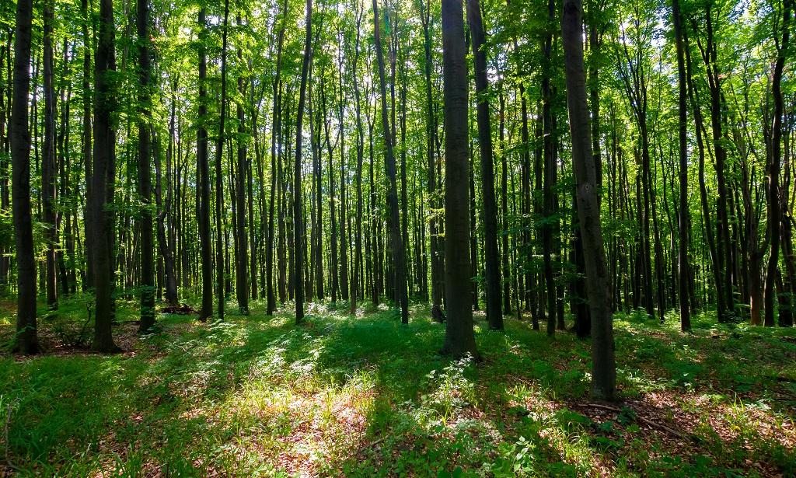
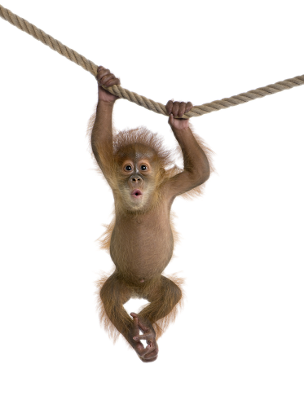
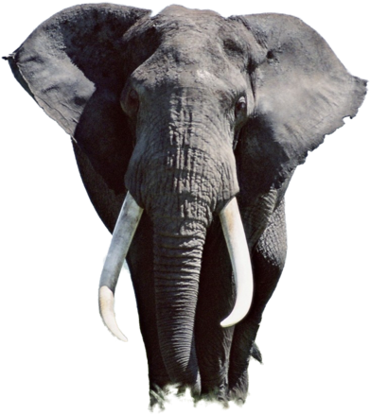
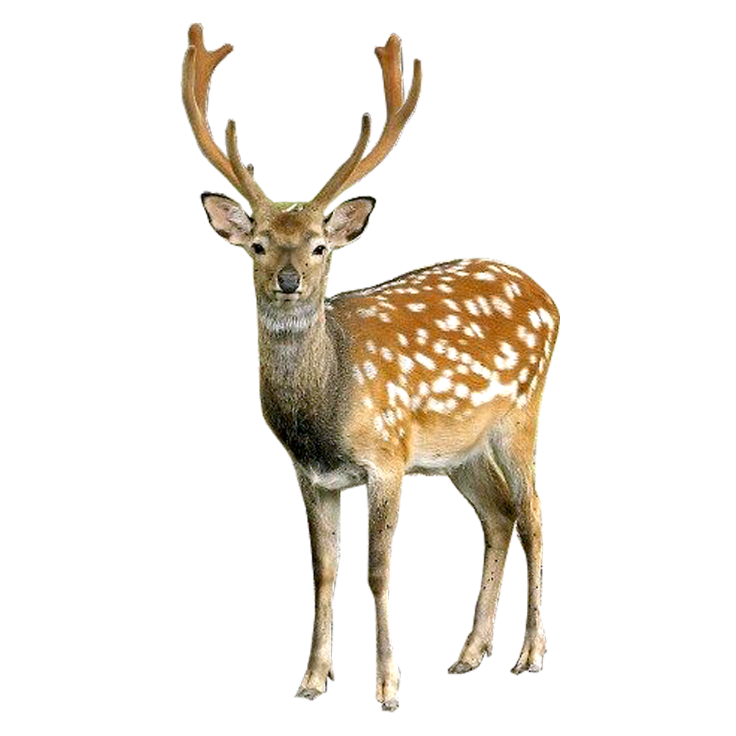
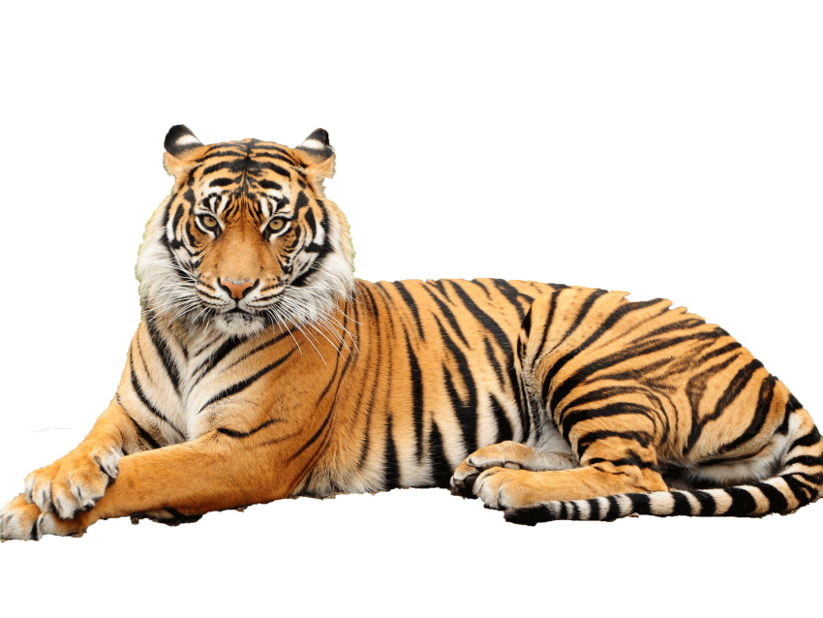

Monkey
Mammal
Butterflies
Invertebrate
Ladybug
Elephant
Invertebrate
Mammal
Tiger
Deer
Mammal
Mammal

Slide 7
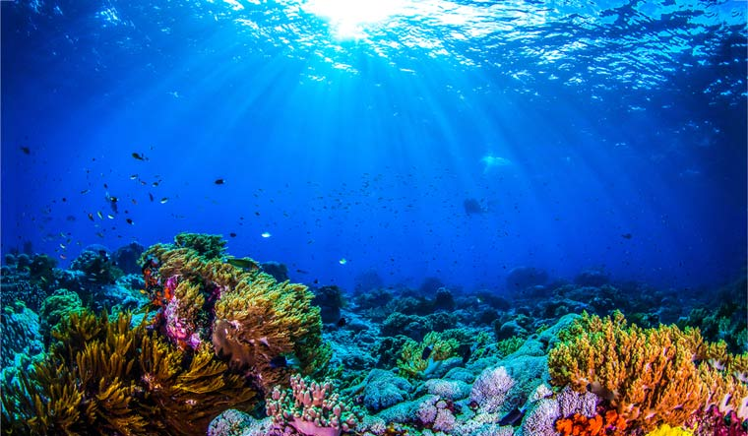
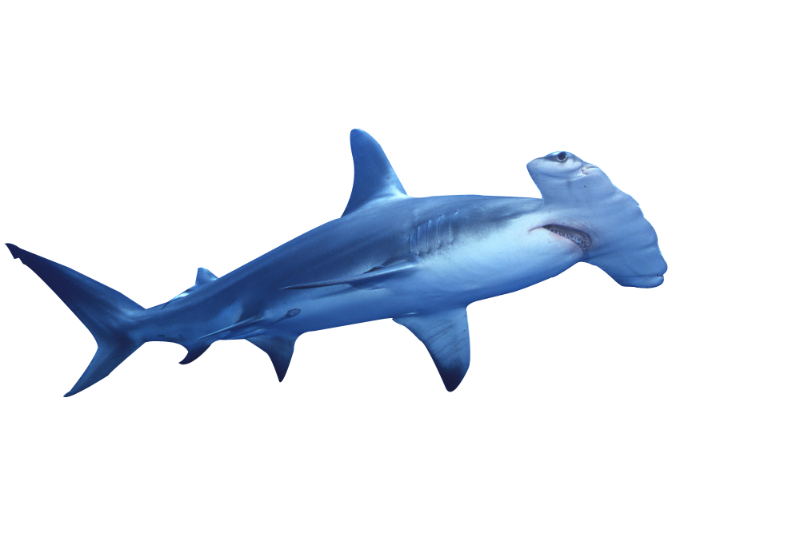
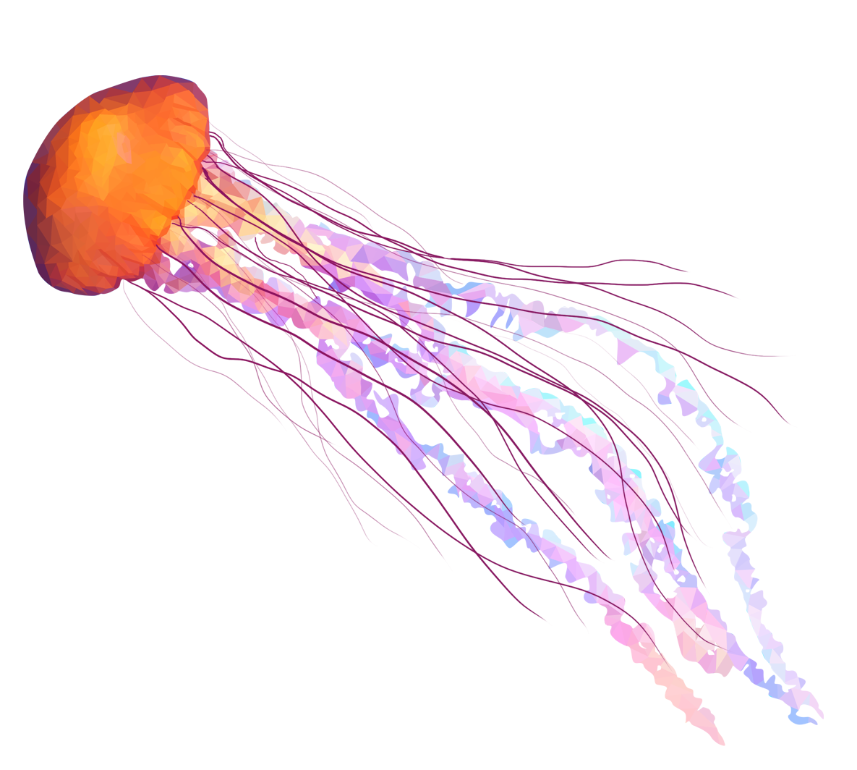
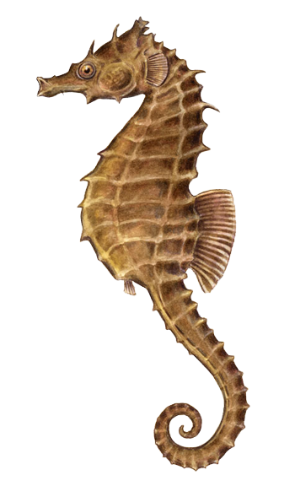
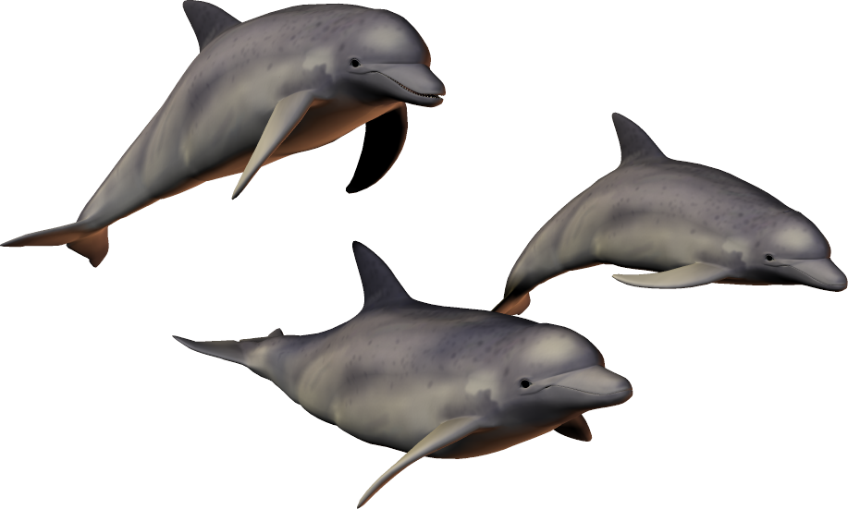
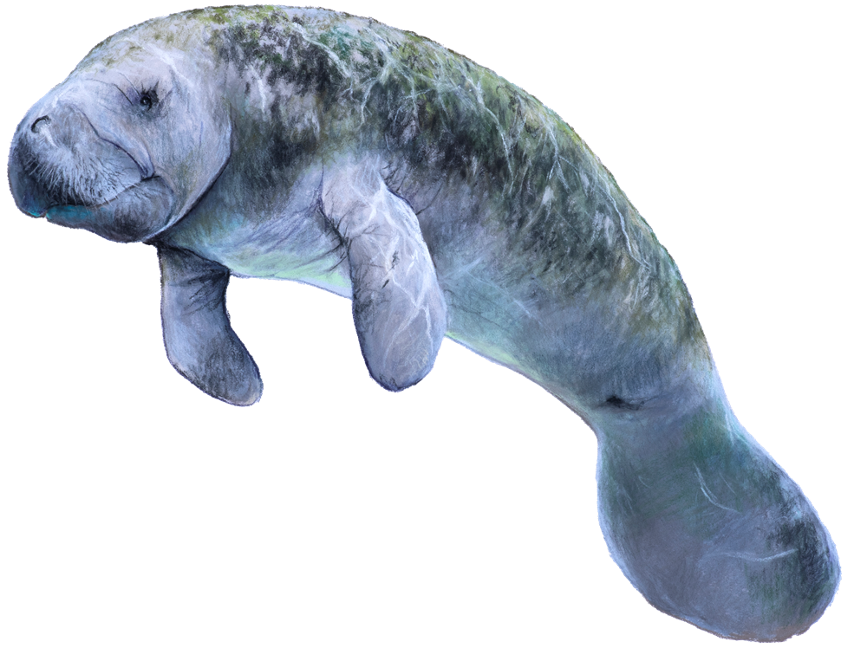
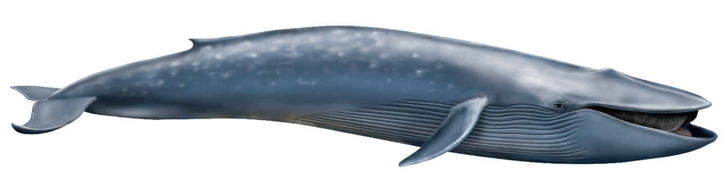
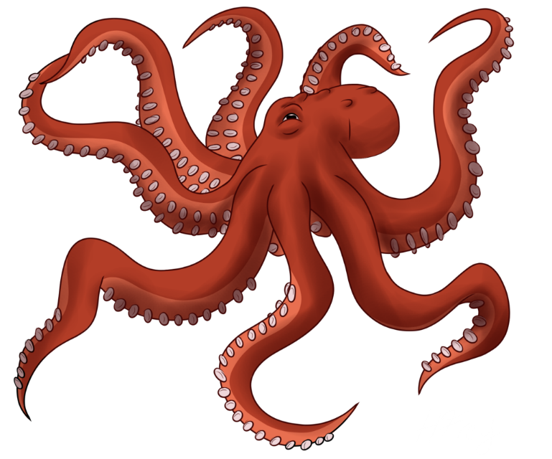
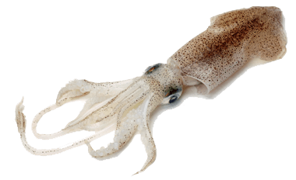
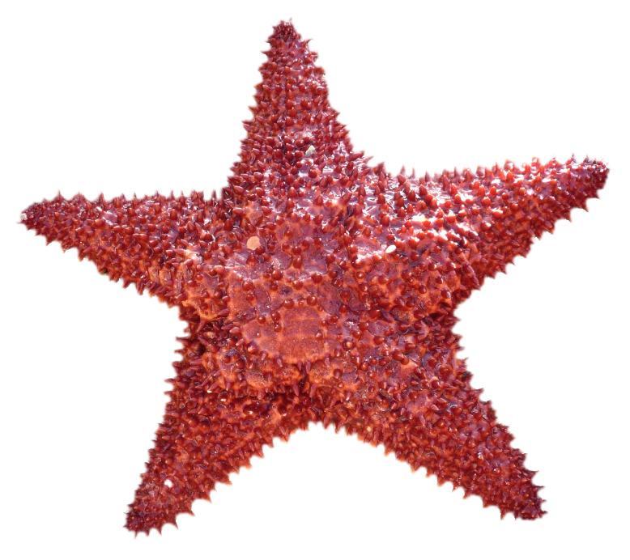
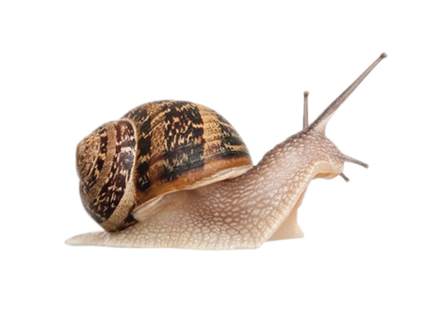
Jellyfish
Blue Whale
Invertebrate
Mammal
Seahorse
Manatee
Hammerhead shark
Fish
Mammal
Dolphins
Fish
Mammal
Squid
Starfish
Octopus
Snail
Invertebrate
Invertebrate
Invertebrate
Invertebrate

Slide 8
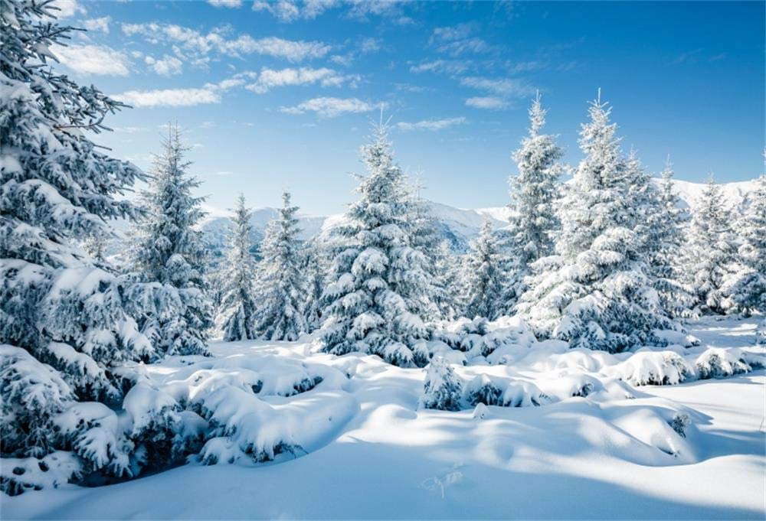
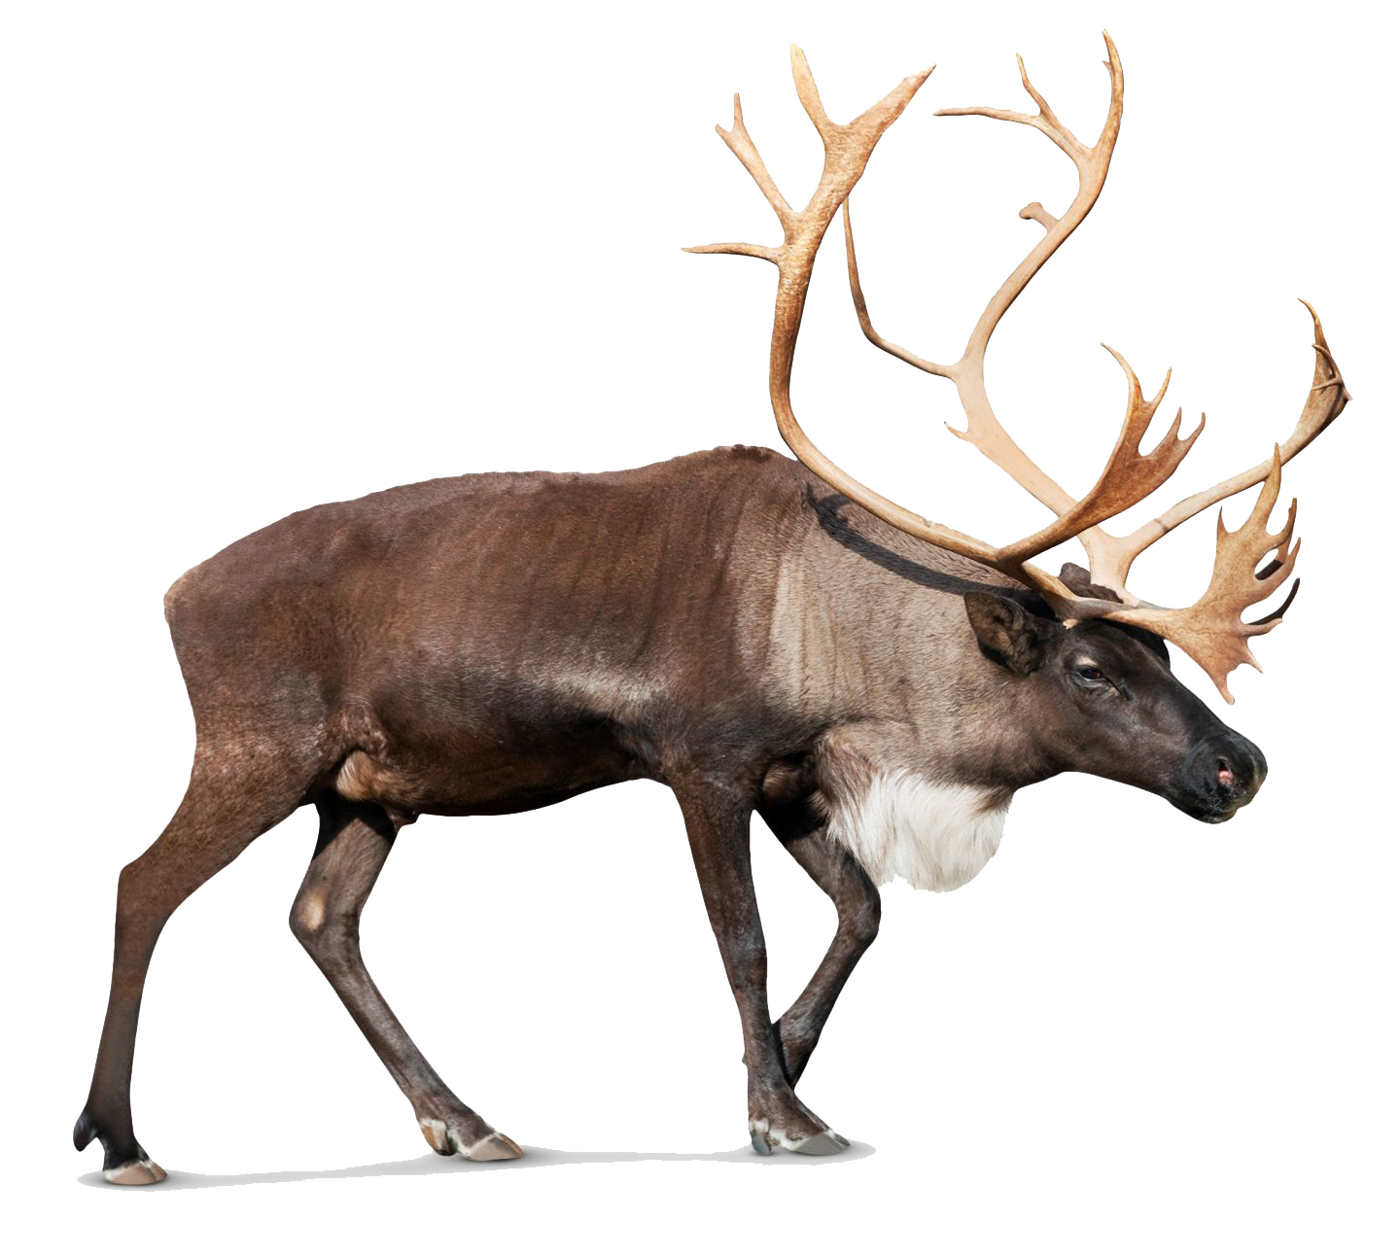
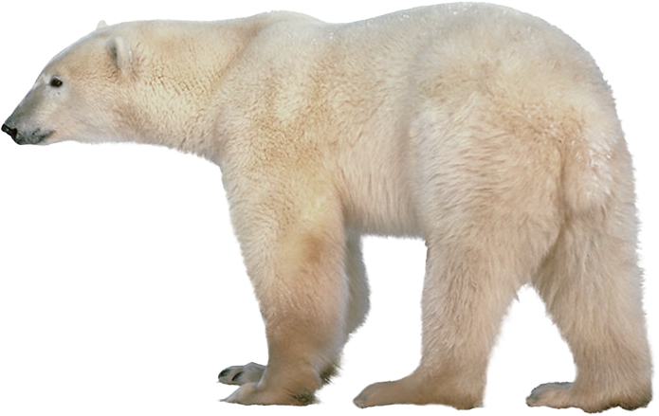
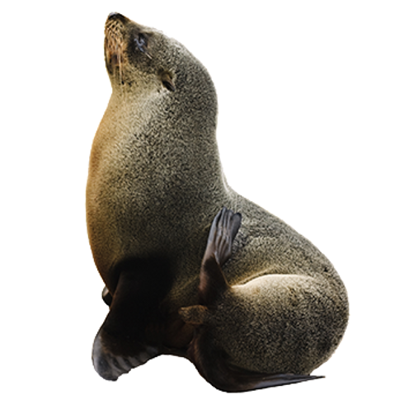
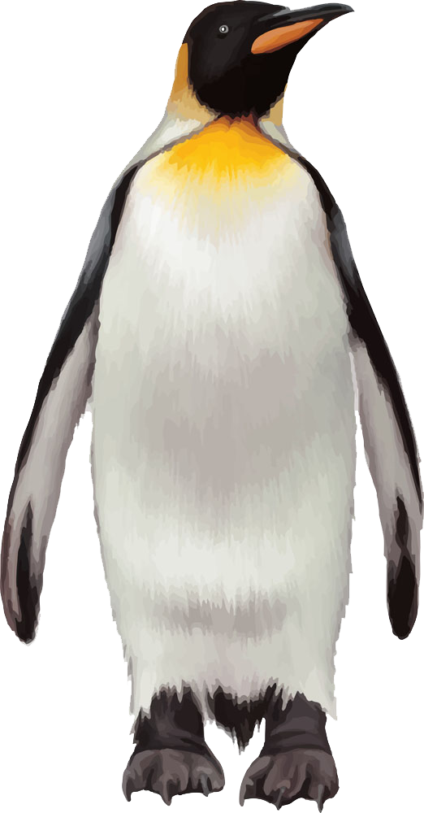
Polar bear
Mammal
Seal
Reindeer
Mammal
Penguin
Mammal
Bird

Slide 9

Homework
EVS 2A workbook
Page 42 , 43

